Slide 1
Team Members
Data Analytics Services

Slide 2

Infomineo has a unique approach to Data Analytics
Analytics
Traditional model
Infomineo model
Most Data analytics companies provide standard models that they transpose from a client to another
Often Data analytics companies provides models that stay in the state of Proof-Of-Concept because integration with IT teams is not complete
Most Data analytics providers are specialized in Visualization tools : Tableau, Power Bi etc.
Most providers work on a project basis – The models are afterwards difficult to maintain over time by the clients' teams
The providers retain rights on the Intellectual property they generate
We are problem solvers, we need to understand your question or challenge and will find the data & models which answers your question
We have a multi capabilities team that can provide you an end-to-end approach from cleaning the data to visualizing the model output
We work on a retainer basis, we are an extension of your team, and make it easy to work with us, which 1/minimizes the time you spend on paperwork and 2/allows you to work with us on an iterative basis
The output is co-constructed with our client and not a model taken off the shelf

Slide 3
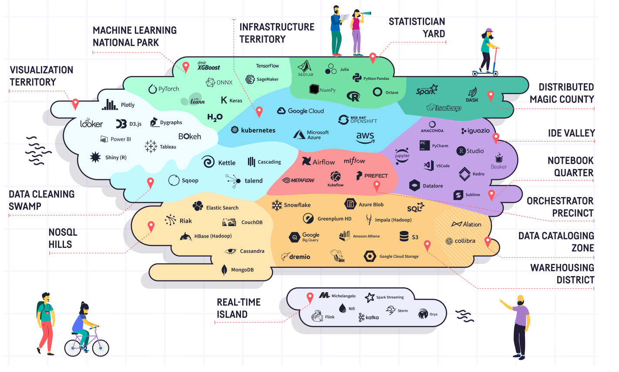

Technologies Infomineo can be handling
Capabilities we already have
Capabilities we are building

Slide 4

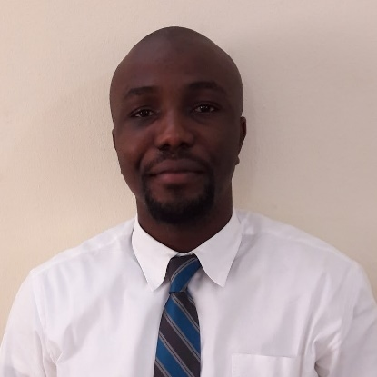


Oludayo Abass
Data Scientist - Casablanca
Professional experience
Oludayo has 7 years of experience working as a data analyst and researcher; developing insights from business, financial & economic data, and helping corporates and consultancies understand the markets in Europe, Middle East & Africa (EMEA).
Oludayo joined Infomineo in 2016.
Education
Technical Skills and Competencies
Oludayo is a graduate of Data Science & Artificial Intelligence from the University of Hull, UK.
Oludayo also holds a B.Sc. in Accounting from Igbinedion University, Nigeria.
Oludayo has also studied portfolio management courses at the Westminster business school, London
Oludayo speaks fluent English.
Data analysis and modelling: Python, SQL, Advanced Excel & VBA, and DAX
Data Visualization: Power BI, Matplotlib, Seaborn
Machine Learning & Deep Learning Algorithms and Frameworks
Business Research & Advisory
Financial Modelling

Slide 5

Lahouani Amine
Senior Data Scientist - Casablanca
Professional experience
Amine a 5 years work experience .
Over 2 years of experience in the investment banking industry. Strong background in data analysis and modeling, with experience in working with large and complex data sets. Skilled in using a variety of tools and technologies, including Python , SQL , VBA , MLops frameworks . MBA holder with engineering background , providing a well-rounded perspective and the ability to bridge technical and business needs. Expertise in Machine Learning, able to develop and implement advanced models to extract insights and make predictions from data. Proven ability to deliver end-to-end solutions, from data collection and cleaning, to model development and deployment.
Education
Technical Skills and Competencies
MBA Degree with Corporate Finance Concentration from the International University of Japan (IUJ) , Japan.
Engineering Degree in Statistics and Economic Modeling from the National Institute of Statistics and Applied Economics ( INSEA) , Morocco
Python Programming , Advanced Excel and VBA , R Programming
Robotic Process Automation (RPA)
MLops : End-to-end Machine Learning Solutions
Data Modeling and Database architecture ( RDBSM (PostgreSQl) , NoSQL ( Cassandra , MongoDB) )
Advanced Econometric and Financial Modeling

Slide 6
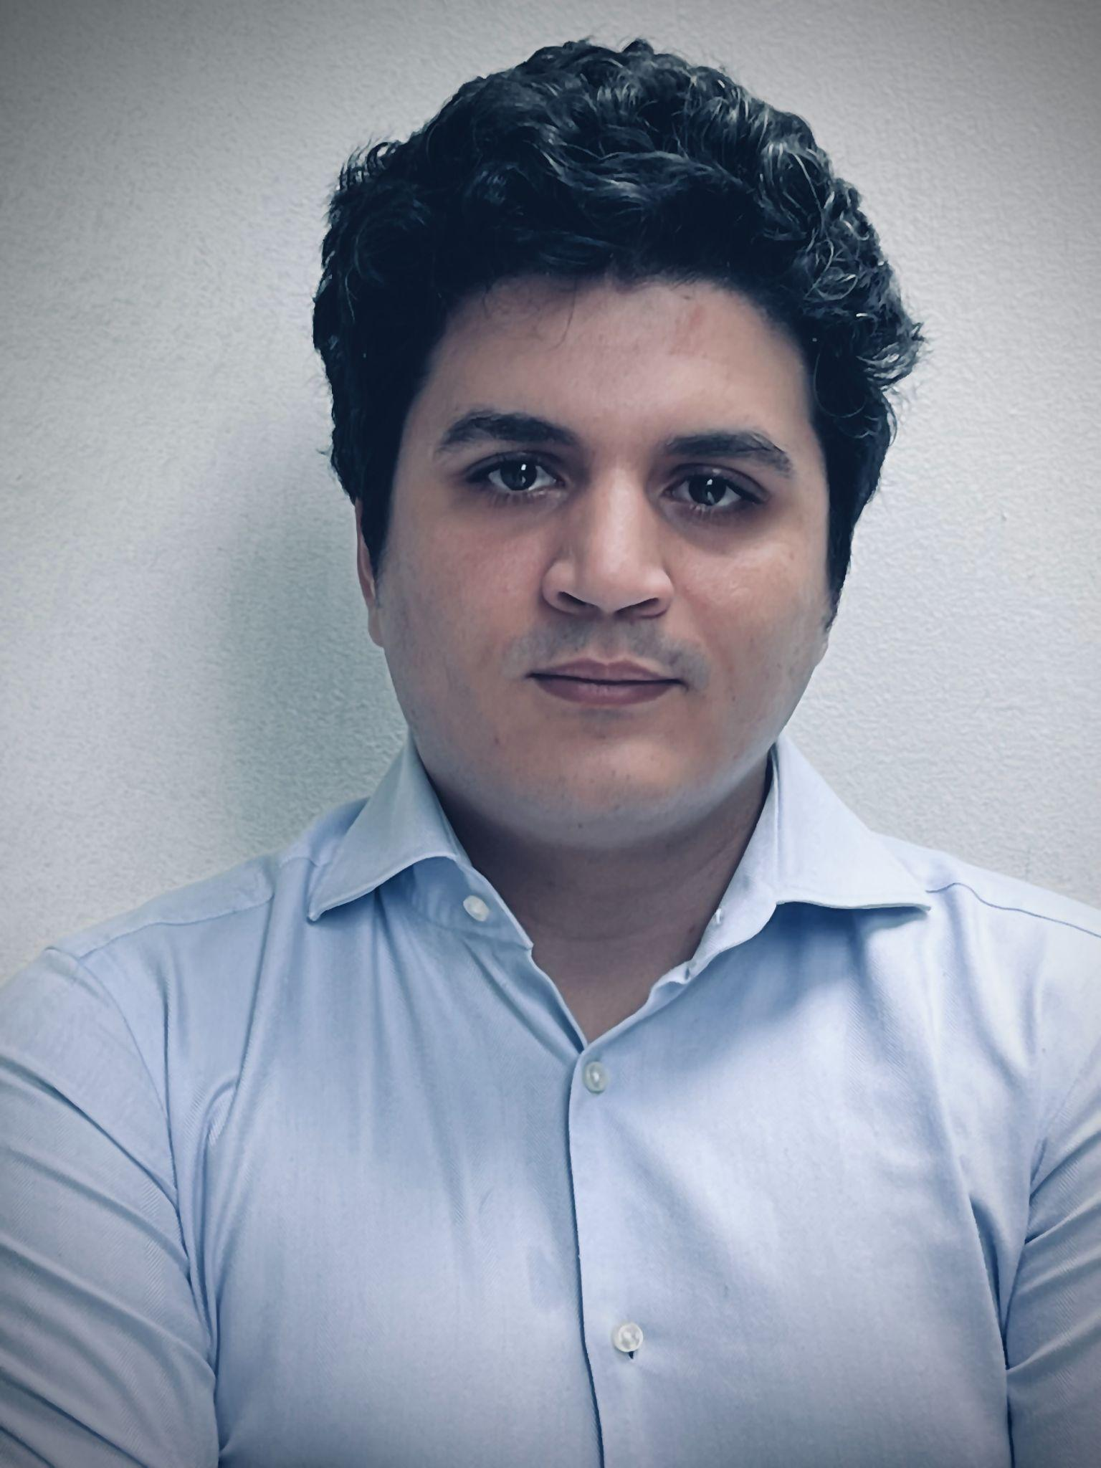
ALAMI Brahim
Senior Data Scientist - Casablanca
Professional experience
Brahim has 3 years of work experience.
He worked in various analytical positions before evolving to a data science career. First as a trainee at PWC PARIS, before joining the French start-up ecosystem as assistant to the CFO and then as Venture Capital Analyst. He then worked for a couple of years as an R&D consultant and co-founded his first start-up, leveraging data science for Dubai’s real estate market.
Brahim Joined Infomineo as Data Scientist in 2023.
Education
Technical Skills and Competencies
Licence Mathématiques appliquées – La Sobonne Paris 1
•PGE Master corporate finance - Skema BS
•Le Wagon Bootcamp of Data Science
•Certified Machine Learning Specialist from MIT IDSS
Data Analysis and visualization : Seaborn, Matplotlib, Power BI
ML/DL algorithms and frameworks
ML OPS and engineering frameworks and tools (SQL, GCP, Docker, Heroku, Prefect, Dataiku …)
Programming languages : Python, Java, C, VBA

Slide 7

Khaoula Qassibi
Data Analyst - Casablanca
Professional experience
Khaoula is a junior Data Analyst specialized in Power Bi. Before joining Infomineo, she did an internship at big tech company where she was mainly working on automation and reporting using Power Bi and SQL. Khaoula is eager about the field of Business Intelligence as it makes her able to efficiently and effectively analyze, and present data in a way that is both meaningful and impactful to help her clients make better data-driven decisions.
Education
Technical Skills and Competencies
Khaoula holds a B.Sc. in Computer Science from Al Akhawayn University
Khaoula has a minor in Business Administration
Khaoula has also studied Agile Project Management courses
Khaoula speaks fluent English.
Data Analysis: SQL, Excel, DAX
Data Modelling: Power Query
Data visualisation: Power BI etc.
Programming Languages : C, Java, Javascript
Databases : PostgreSQL, SQL Server (SQL), MongoDB(NoSQL)

Slide 8

Youssef Moutaouakkil
Data Scientist - Casablanca
Professional experience
Youssef is a Junior Data Scientist with a background in Industrial engineering. Before joining Infomineo, he did an internship at UM6P as an Applied Scientist where he developed an end-to-end computer vision solution. Youssef is passionate about the field of AI and Data science as a tool to help companies discover more insights and automate tasks.
Education
Technical Skills and Competencies
Engineering degree in Industrial Engineering, DS.
Tensorflow developer certified
Data Analysis & Visualization: Data manipulation, Statistical analysis & interactive visuals
ML/DL Models: State-of-the-art NLP & Computer vision
Programming languages: Python, SQL, Javascript, Bash, Dax
Software : Power BI, Tableau

